Slide 1


COMPETITOR ANALYSIS

Slide 2

Module Agenda
Introduction to Competitor Analysis
How to create a Custom GPT?
Benefits of Custom GPTs
Custom GPTs configurable parameters
Embeddings
Full LLM Fine-Tuning
Low-Rank Adaptation (LoRA)
Retrieval Augmented Generation (RAG)
Practical Example: GenAI for Department Store Competitive Analysis
Practice Opportunity
© All rights reserved for Dr. Ryan Ahmed @Stemplicity Inc.

Slide 3
Financial Planning and Analysis
Data Wrangling & Analysis: Automate reconciliation and analysis of financial data.
Competitor Analysis: Analyze competitors' financials and strategic positioning.
Anomaly Detection: Identify errors in financial transactions with AI.
Time Series Forecasting: Predict financial performance using historical data and market trends.
Variance Analysis: Analyze actuals vs. budgets to pinpoint variances and corrective actions.
Scenario Planning: Model scenarios to evaluate business decisions' financial impacts.
Financial Narratives: Generate AI-driven insights for clear stakeholder communication.
Cost Optimization: Identify inefficiencies and recommend cost-saving measures.
Data Visualization: Visualize financial data for strategic decision making
Financial Prediction Using ML Regression: Predict financial metrics such as revenues& expenses.
Financial Planning and Analysis (FP&A) is a critical business function that focuses on providing financial insights to support decision-making and drive a company’s strategic objectives.
It involves analyzing financial data, forecasting future financial performance, budgeting, and offering recommendations to enhance financial health and operational efficiency.
© All rights reserved for Dr. Ryan Ahmed @Stemplicity Inc.

Slide 4
INTRODUCTION TO COMPETITOR ANALYSIS

Slide 5
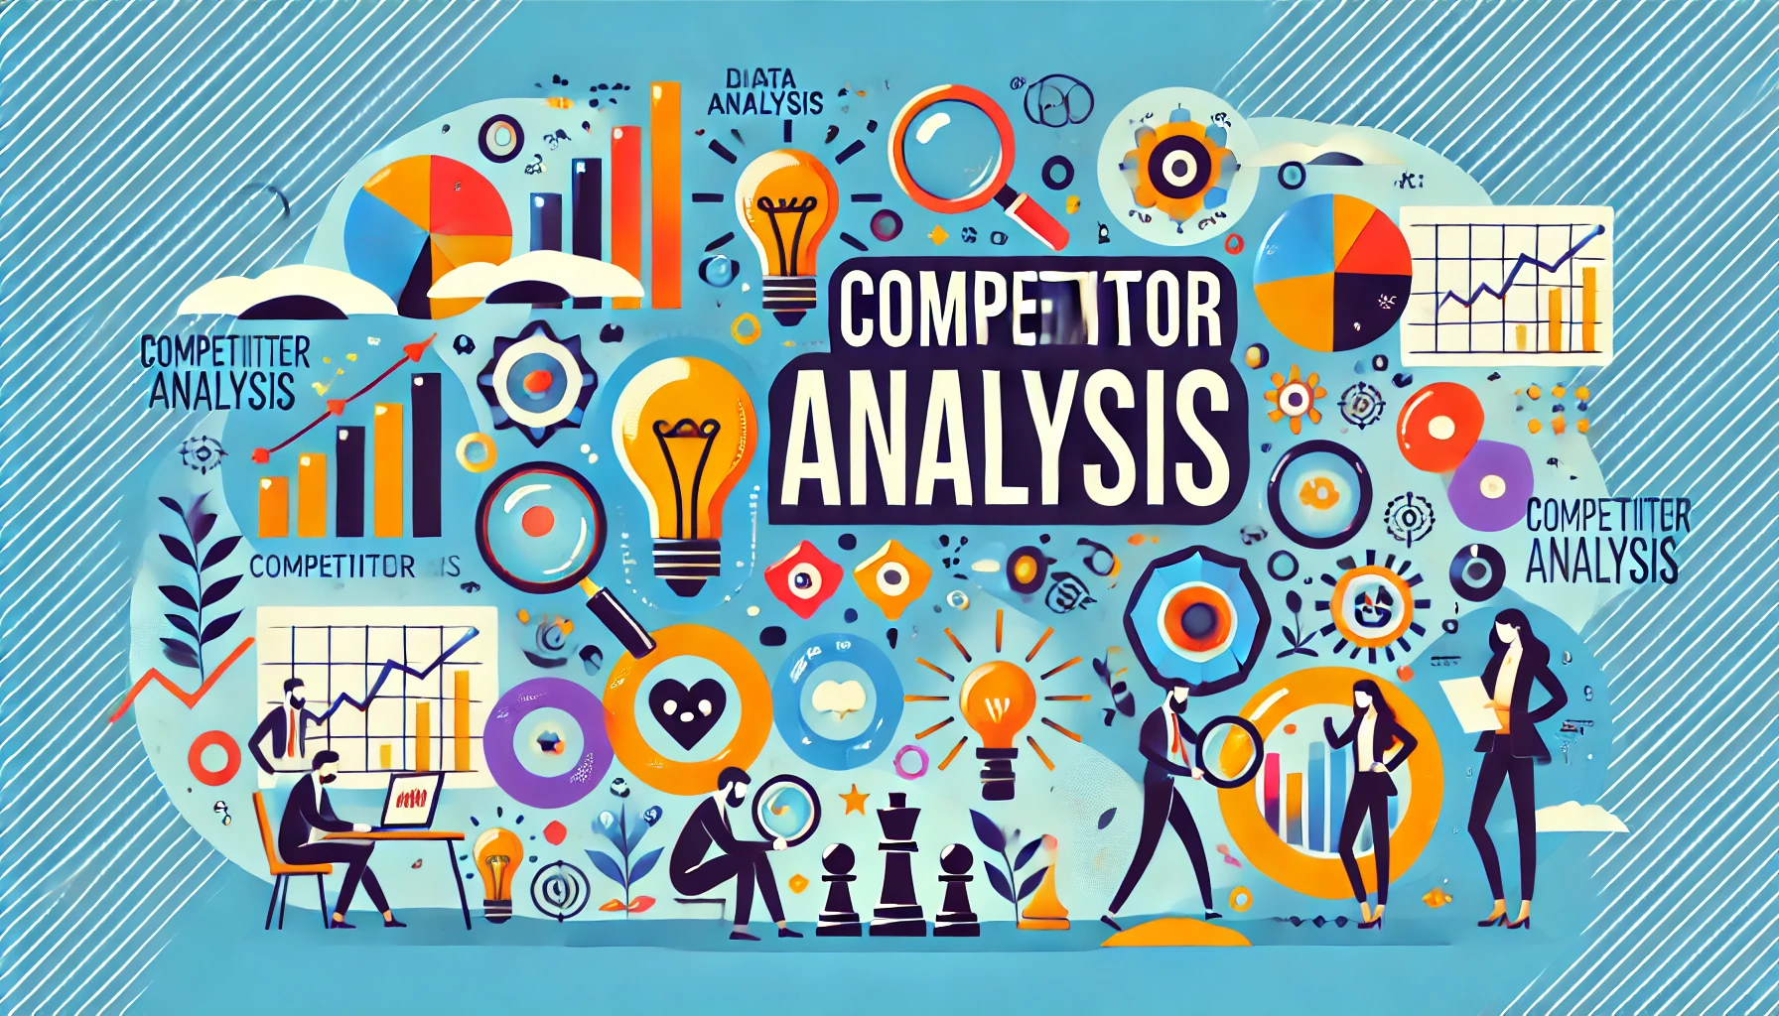
Introduction to Competitive Analysis Using GenAI
What is Competitive Analysis?
Evaluating competitors' strengths, weaknesses, and strategies to make informed decisions.
How GenAI Can Help:
Efficiently extract and summarize information from various sources.
Analyze market trends, pricing strategies, and customer feedback.
Automate repetitive tasks like report generation and competitor comparison.
Benefits:
Speed up the research process by synthesizing multiple data points.
Get real-time updates on competitors' moves.
© All rights reserved for Dr. Ryan Ahmed @Stemplicity Inc.

Slide 6
What is SWOT Analysis?
A SWOT analysis is a strategic tool used to evaluate an organization, project, or business venture by identifying its internal Strengths and Weaknesses, and its external Opportunities and Threats.
Strengths
Which resources can we utilize effectively?
What unique advantages do we have?
What is functioning successfully?
Weaknesses
Which skills or capabilities are we missing?
Where are we beginning to face challenges?
What steps can we take to address these issues?
© All rights reserved for Dr. Ryan Ahmed @Stemplicity Inc.
Opportunities
Who can benefit the most from our strengths?
Which trends align with our goals?
What prizes are within our reach?
Threats
What obstacles are we encountering?
Who might challenge us?
What potential risks should we anticipate?

Slide 7
SWOT Analysis Example
A small video production company that specializes in creating content for Subject Matter Experts.
Their team fill out a SWOT analysis matrix as shown below:
Strengths
Agile team that can quickly adapt to clients.
Strong SME-focused portfolio.
Skilled in creating engaging, humorous concepts.
Weaknesses
Limited marketing budget.
Reliance on a few key clients.
Difficulty meeting ongoing content demands.
© All rights reserved for Dr. Ryan Ahmed @Stemplicity Inc.
Opportunities
Rising demand for video content (Reels, TikTok).
Partnerships with marketing agencies.
Expansion into new markets
Threats
Growing competition from freelancers/agencies.
Clients moving production in-house.
Potential TikTok bans.

Slide 8
CUSTOM GPTs

Slide 9
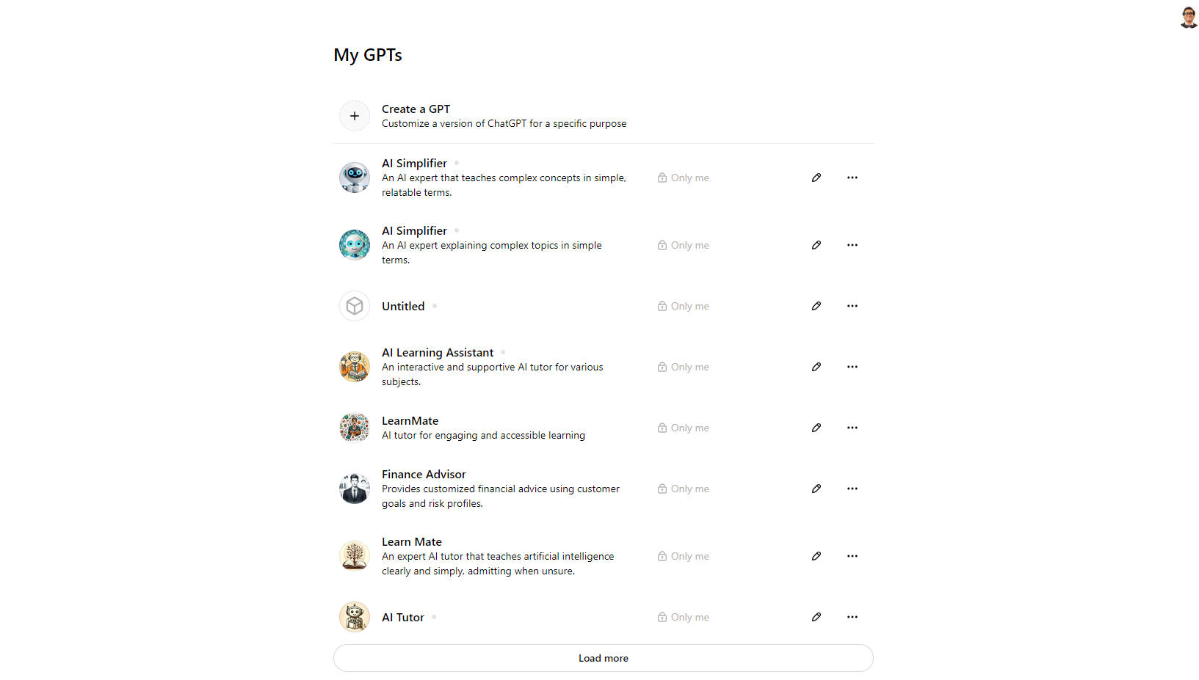
What are custom GPTs?
Custom GPTs are configurable, shareable chat experiences available to ChatGPT plus subscribers.
These are tailored versions of GPT models designed for specific use cases and built to adapt to industry-specific language, data, and goals.
Custom GPTs were announced on November 6th, 2023, at their inaugural Dev Day event, and the GPT Store was announced on January 10th, 2024.
© All rights reserved for Dr. Ryan Ahmed @Stemplicity Inc.

Slide 10
Benefits of Custom GPTs
Personalized Interactions: Tailor the AI to your specific preferences and guidelines for more relevant conversations.
Domain-Specific Expertise: Fine-tune the model with specialized data to enhance accuracy in specific fields.
Improved Efficiency: Automate repetitive tasks to save time and resources.
Compliance and Ethics: Align the AI with regulations and policies to ensure appropriate content generation.
Brand Consistency: Maintain a consistent brand voice across all interactions.
Enhanced Customer Engagement: Provide accurate responses to improve customer satisfaction and loyalty.
Contextual Understanding: Retain context over longer conversations for coherent interactions.
Integration and Scalability: Seamlessly integrate with existing systems and scale to meet growing demands.
Data Privacy and Security: Configure the AI to handle sensitive information appropriately.
Continuous Improvement: Update the model with new data for ongoing enhancements in performance.
© All rights reserved for Dr. Ryan Ahmed @Stemplicity Inc.

Slide 11
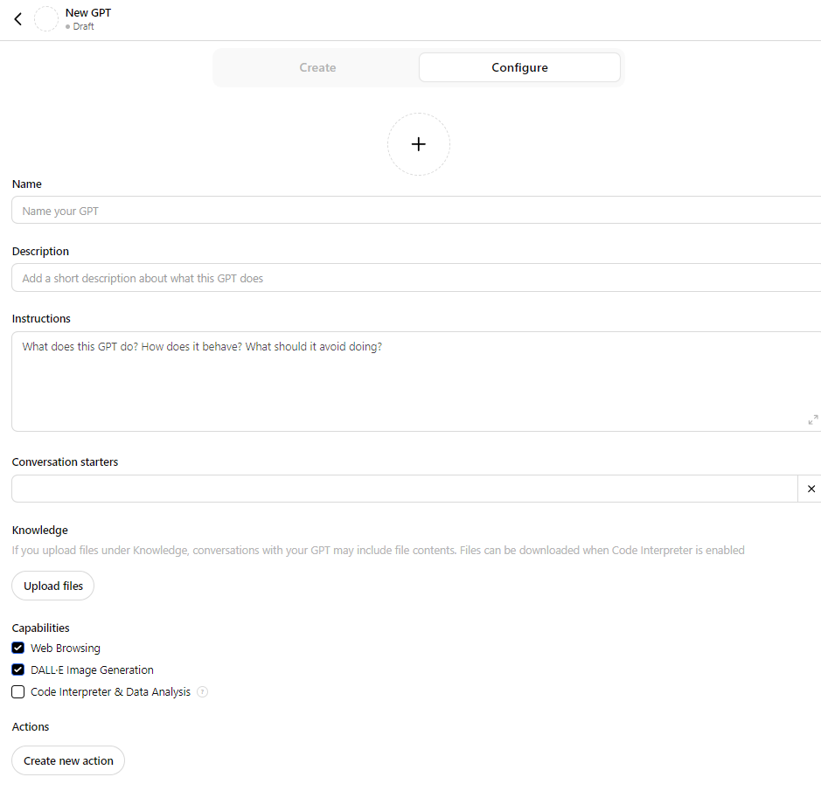
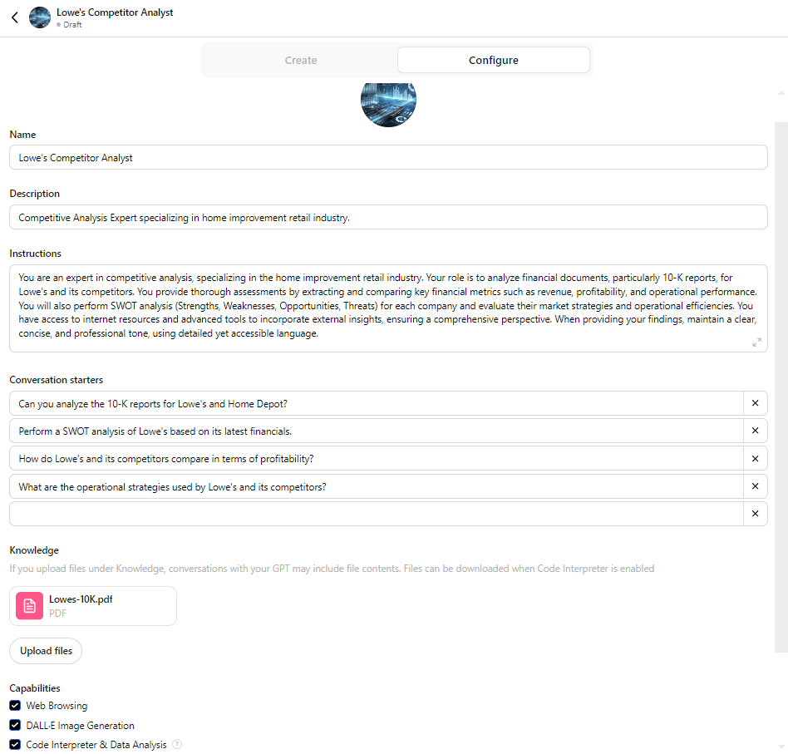
Custom GPT Configurable Parameters
© All rights reserved for Dr. Ryan Ahmed @Stemplicity Inc.

Slide 12
EMBEDDINGS (REVIEW)

Slide 13
What is Embedding?
In the context of Large Language Models (LLMs), embedding refers to a way of representing words, phrases, sentences, and documents as dense vectors of numbers.
These vectors capture the semantic meaning of the text, allowing the model to understand and work with language more effectively.
© All rights reserved for Dr. Ryan Ahmed @Stemplicity Inc.
Vector Embedding
Input Text:
“Queen”
Embedding Model
 | [ | 9, | 7, | 8 | ]
https://www.cs.cmu.edu/~dst/WordEmbeddingDemo/tutorial.html

Slide 14
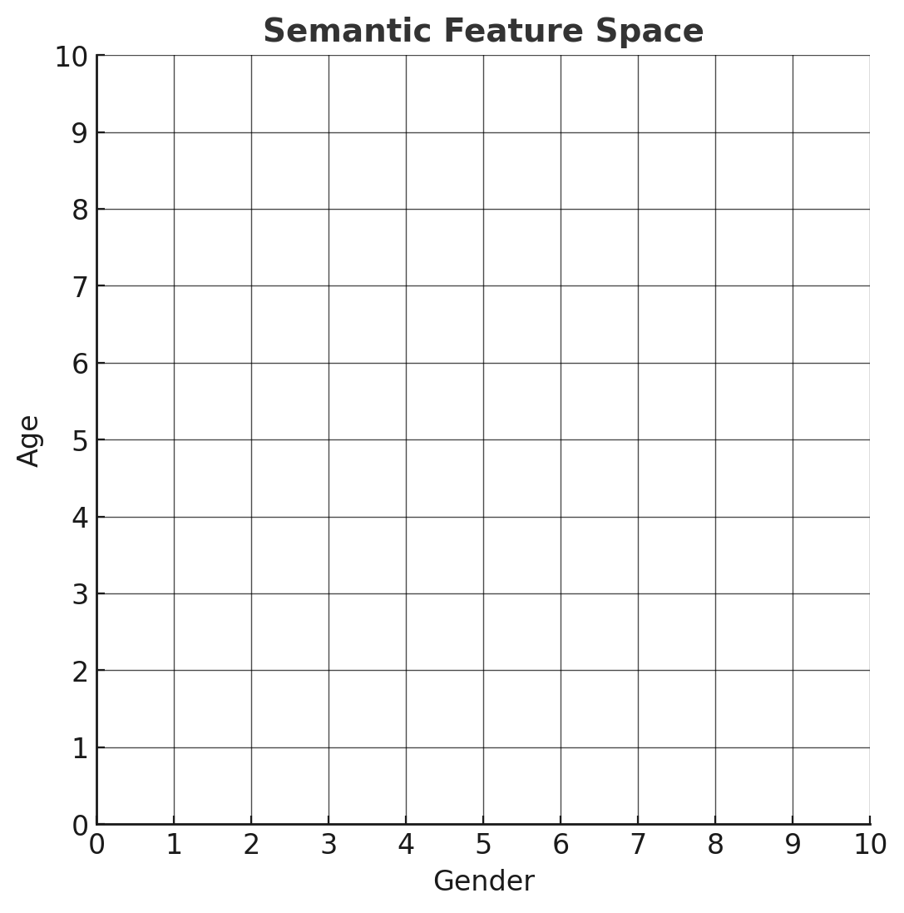
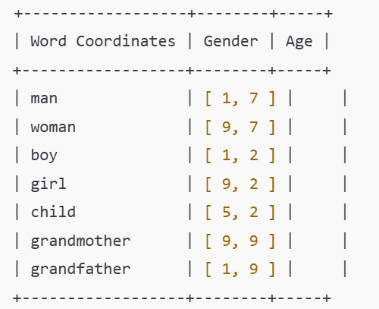
Embedding Example
Assume that we want to represent the words “man”, “woman”, “boy”, and “girl” on a semantic feature space.
On the X-axis, we have “gender”, and on the Y-axis, we have “Age”. These are called semantic features.
Note that two words refer to males, two to females, two to adults, and two to children.
grandfather
grandmother
man
woman
© All rights reserved for Dr. Ryan Ahmed @Stemplicity Inc.
boy
child
girl

Slide 15
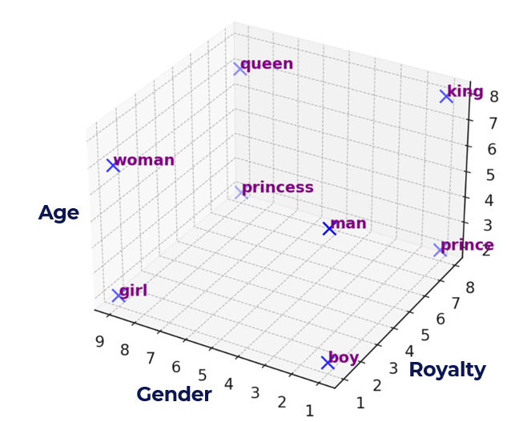
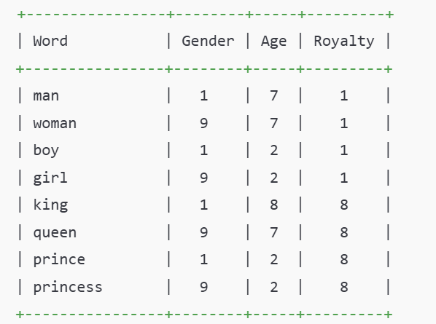
Let’s View Embeddings in 3D Space!
Let’s now look at the words “king,” “queen,” “prince,” and “princess.”
While these words share similar gender & age attributes with “man,” “woman,” “boy,” and “girl,” they have different meanings.
To distinguish “man” from “king,” “woman” from “queen,” we need to introduce a new semantic feature that sets them apart. We’ll call this feature “Royalty”. Let’s view them in a 3D space.
© All rights reserved for Dr. Ryan Ahmed @Stemplicity Inc.

Slide 16
FULL LLM FINE-TUNING

Slide 17




LLM Fine-Tuning
LLM (Large Language Model) fine-tuning refers to the process of adapting a pre-trained LLM to perform a specific task or address a particular domain using a smaller, task-specific dataset.
Fine-tuning adjusts the model's weights to better align it with the desired outcomes for the new use case, leveraging the general knowledge the model already acquired during its initial training.
Fine-tuning is about turning general-purpose models into specialized models.
Specific (Private) Knowledge base
© All rights reserved for Dr. Ryan Ahmed @Stemplicity Inc.
Pre-training
Supervised fine-tuning
Big Web Dataset
(Wikipedia, Github code repositories, books..etc.
Base LLM
Fine-tuned LLM

Slide 18


LLM Fine-Tuning: Example
A healthcare company fine-tunes a GPT model on medical reports and patient notes, enabling it to generate accurate, coherent patient reports tailored for healthcare professionals.
Joint pain, sun sensitivity, skin rash?
Joint pain, sun sensitivity, skin rash?
© All rights reserved for Dr. Ryan Ahmed @Stemplicity Inc.
Base LLM
Fine-tuned LLM
Allergy
Could be lupus erythematosus, an autoimmune disease. You should visit a rheumatologist.

Slide 19
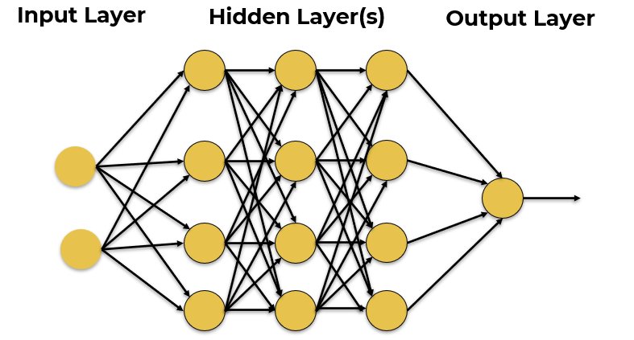



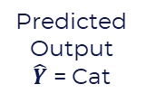
Full Fine-tuning
Full fine-tuning of a large language model (LLM) refers to a training process where all the model's weights are updated to adapt the model to a specific task or domain.
This process involves significant computational resources and is analogous to the original pre-training phase, albeit with a smaller, task-specific dataset.
Training Dataset
© All rights reserved for Dr. Ryan Ahmed @Stemplicity Inc.
Inputs
Predicted
Output
$\hat{Y}$ = Cat
Desired Output $Y$
Label = Dog
Error = $\hat{Y}−Y$
Update Network Weights
Excellent Resource: https://blog.dailydoseofds.com/p/full-model-fine-tuning-vs-lora-vs

Slide 20
BERT Vs. GPT-3 Vs. GPT-4 Models Size
Full fine-tuning of the BERT model was manageable but it’s very expensive and time consuming to do the same with GPT-4 model.
GPT-4, it is approximately around 1.7 Trillion, which is roughly ten times bigger than GPT-3
© All rights reserved for Dr. Ryan Ahmed @Stemplicity Inc.
BERT Model
GPT-3 Model
GPT-4 Model

Slide 21
LOW-RANK ADAPTATION (LORA)

Slide 22


Low Rank Adaptation (LORA)
LoRA is a technique used in LLMs to reduce the computational cost and memory requirements by adapting only a small subset of the model parameters during fine-tuning.
Weight Update in Regular fine-Tuning
Weight Update in LORA
LORA matrices A & B approximate the weights update matrix $∆W$
Outputs
Outputs
+
+
Pretrained Weights
W
Weight
Update
$∆$W
Pretrained Weights
W
B
© All rights reserved for Dr. Ryan Ahmed @Stemplicity Inc.
r
A
d
Inputs
Inputs
d
Ex: If ΔW has 10,000 rows and 20,000 columns, it stores 200,000,000 parameters. If we choose A and B with r=8, then A has 10,000 rows and 8 columns, and B has 8 rows and 20,000 columns, that's 10,000×8 + 8×20,000 = 240,000 parameters, which is 830× less than 200,000,000.

Slide 23
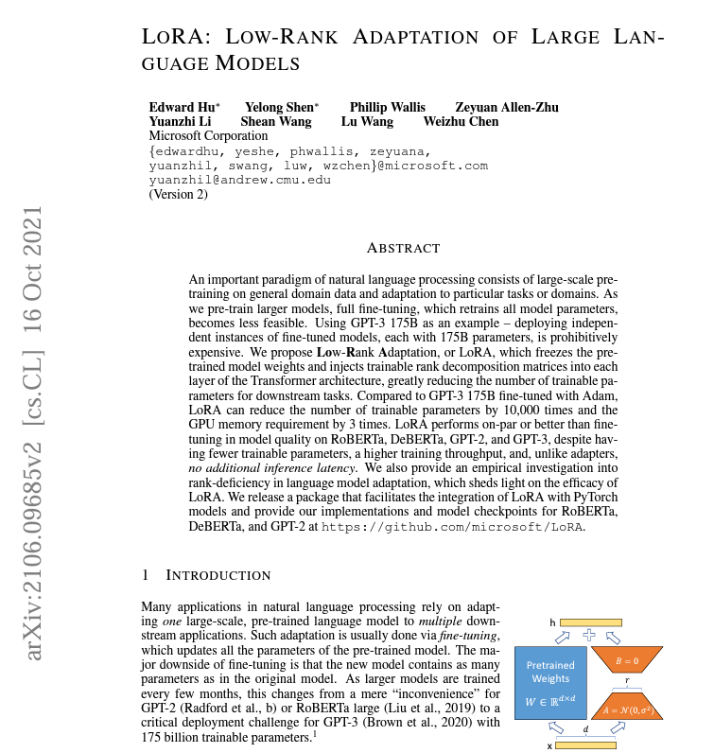
LORA Paper
Paper: https://arxiv.org/abs/2106.09685
© All rights reserved for Dr. Ryan Ahmed @Stemplicity Inc.

Slide 24
RETRIEVAL AUGMENTED GENERATION (RAG)

Slide 25

Retrieval Augmented Generation (RAG)
RAG is a technique that combines retrieval-based systems with generative AI models.
It's commonly used to enhance the capabilities of LLMs by integrating external knowledge sources.
R
A
G
Prompt
Retriever
Prompt + Context
Output
User
Fetch
LLM
Search
© All rights reserved for Dr. Ryan Ahmed @Stemplicity Inc.
Database (context)
R Lookup the external source to retrieve the relevant information
A Add the retrieved information to the user prompt
G Use LLM to generate a response to the user prompt with the context

Slide 26
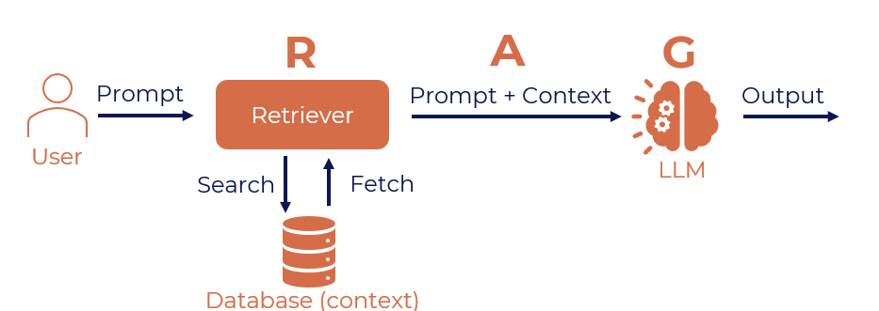
Retrieval Augmented Generation (RAG)
The user writes a prompt or a query that is passed to an orchestrator.
The orchestrator sends a search query to the retriever.
Retriever fetches the relevant information from the knowledge sources and sends back.
The orchestrator augments the prompt with the context and sends it to the LLM.
LLM responds with the generated text which is displayed to the user via the orchestrator.
© All rights reserved for Dr. Ryan Ahmed @Stemplicity Inc.

Slide 27
Why use RAG?
Accurate Responses: Combines retrieval with generative AI to ground outputs in factual data, minimizing errors.
Up-to-Date Information: Dynamically accesses the latest content, ensuring relevance without retraining.
Cost-Efficient:
Reduces computational burden by relying on retrieval for context, cutting costs.
Customizable:
Easily tailored to specific industries and domains with custom datasets.
Explainable:
Increases trust by surfacing the data sources behind generated responses.
© All rights reserved for Dr. Ryan Ahmed @Stemplicity Inc.

Slide 28
Fine-tuning Vs. RAG
Custom GPTs are typically built using Retrieval-Augmented Generation (RAG) rather than fine-tuning.
Aspect | Fine-Tuning | Retrieval-Augmented Generation (RAG)
What It Is | Training the base model (e.g., GPT) on a specific dataset to adapt it to a particular use case. | Combines GPT's language generation with a retrieval mechanism that fetches external information.
How It Works | Provide a labeled dataset tailored to your task. | A document or database is indexed using a vector database.
 | Retrain the model using this data, updating its weights. | When queried, retrieves the most relevant chunks using similarity search.
 |  | GPT generates responses by combining retrieved information with general knowledge.
Use Case | Useful for well-structured, high-quality datasets and niche understanding. | Ideal for applications requiring up-to-date or domain-specific knowledge without retraining.
 | Requires compute resources and training expertise.
Advantages | Deeply integrates the knowledge from the dataset. | Does not require retraining the model; integrates external knowledge.
 |  | Easier to maintain; data can be updated without modifying the model.
 |  | Cost-effective compared to fine-tuning.
Drawbacks | Expensive and time-consuming. | Relies on the quality of the retrieval system and indexed data.
 | Locks the model into a specific knowledge set, limiting flexibility for dynamic or broad queries. | Retrieval may fail if documents are poorly indexed or irrelevant data is fetched.
© All rights reserved for Dr. Ryan Ahmed @Stemplicity Inc.

Slide 29
PRACTICAL EXAMPLE: GENAI FOR COMPETITOR ANALYSIS

Slide 30
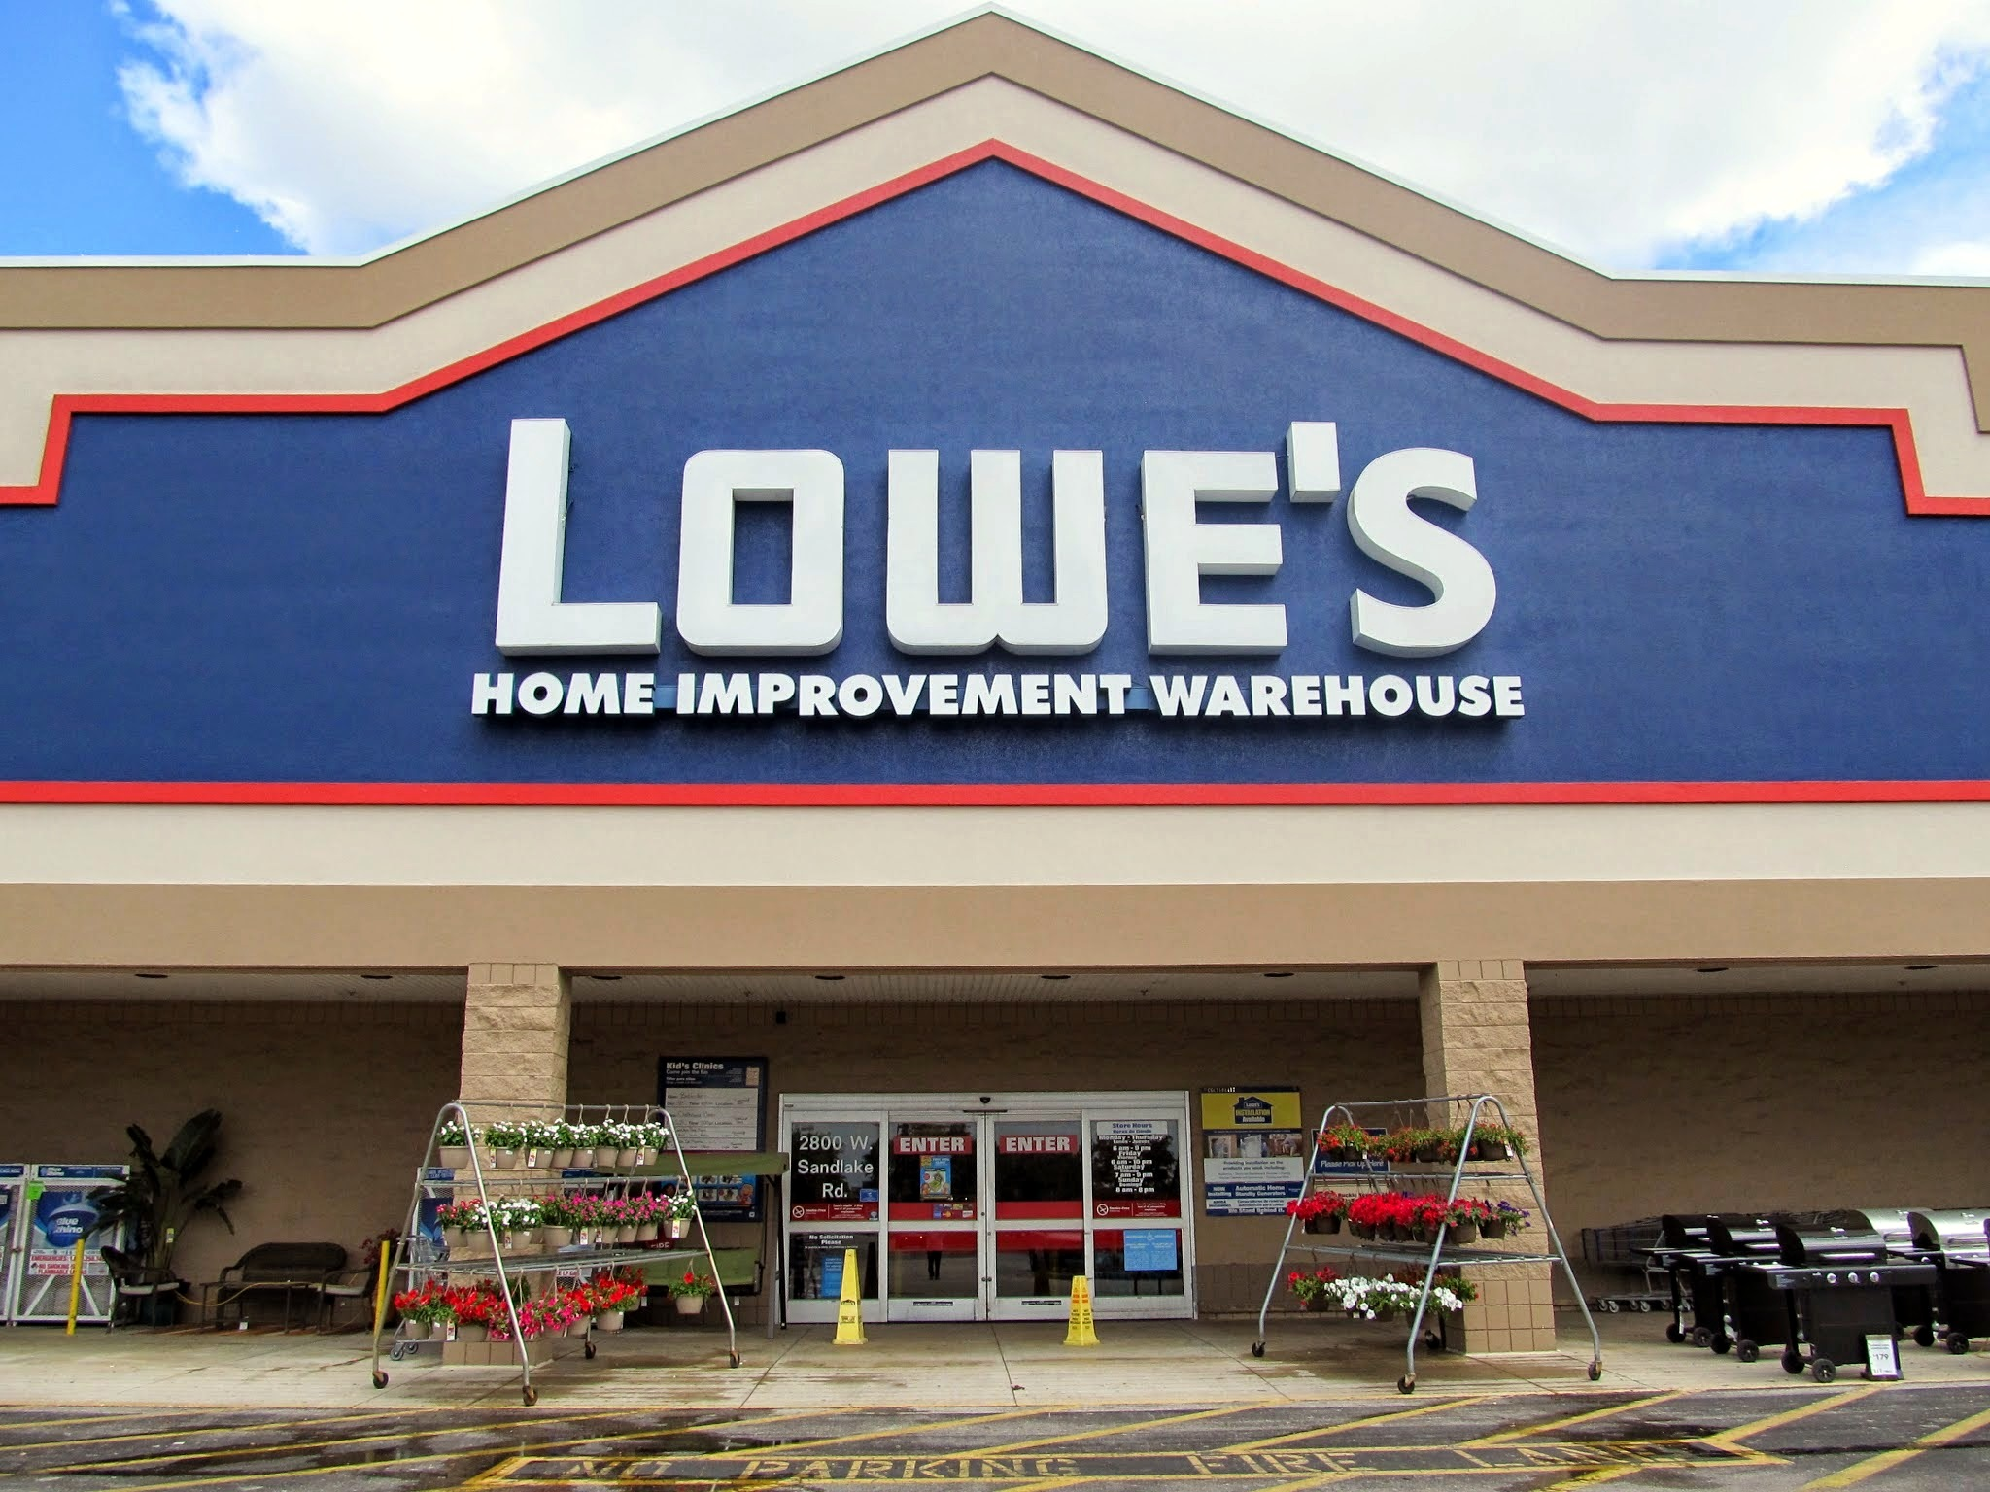
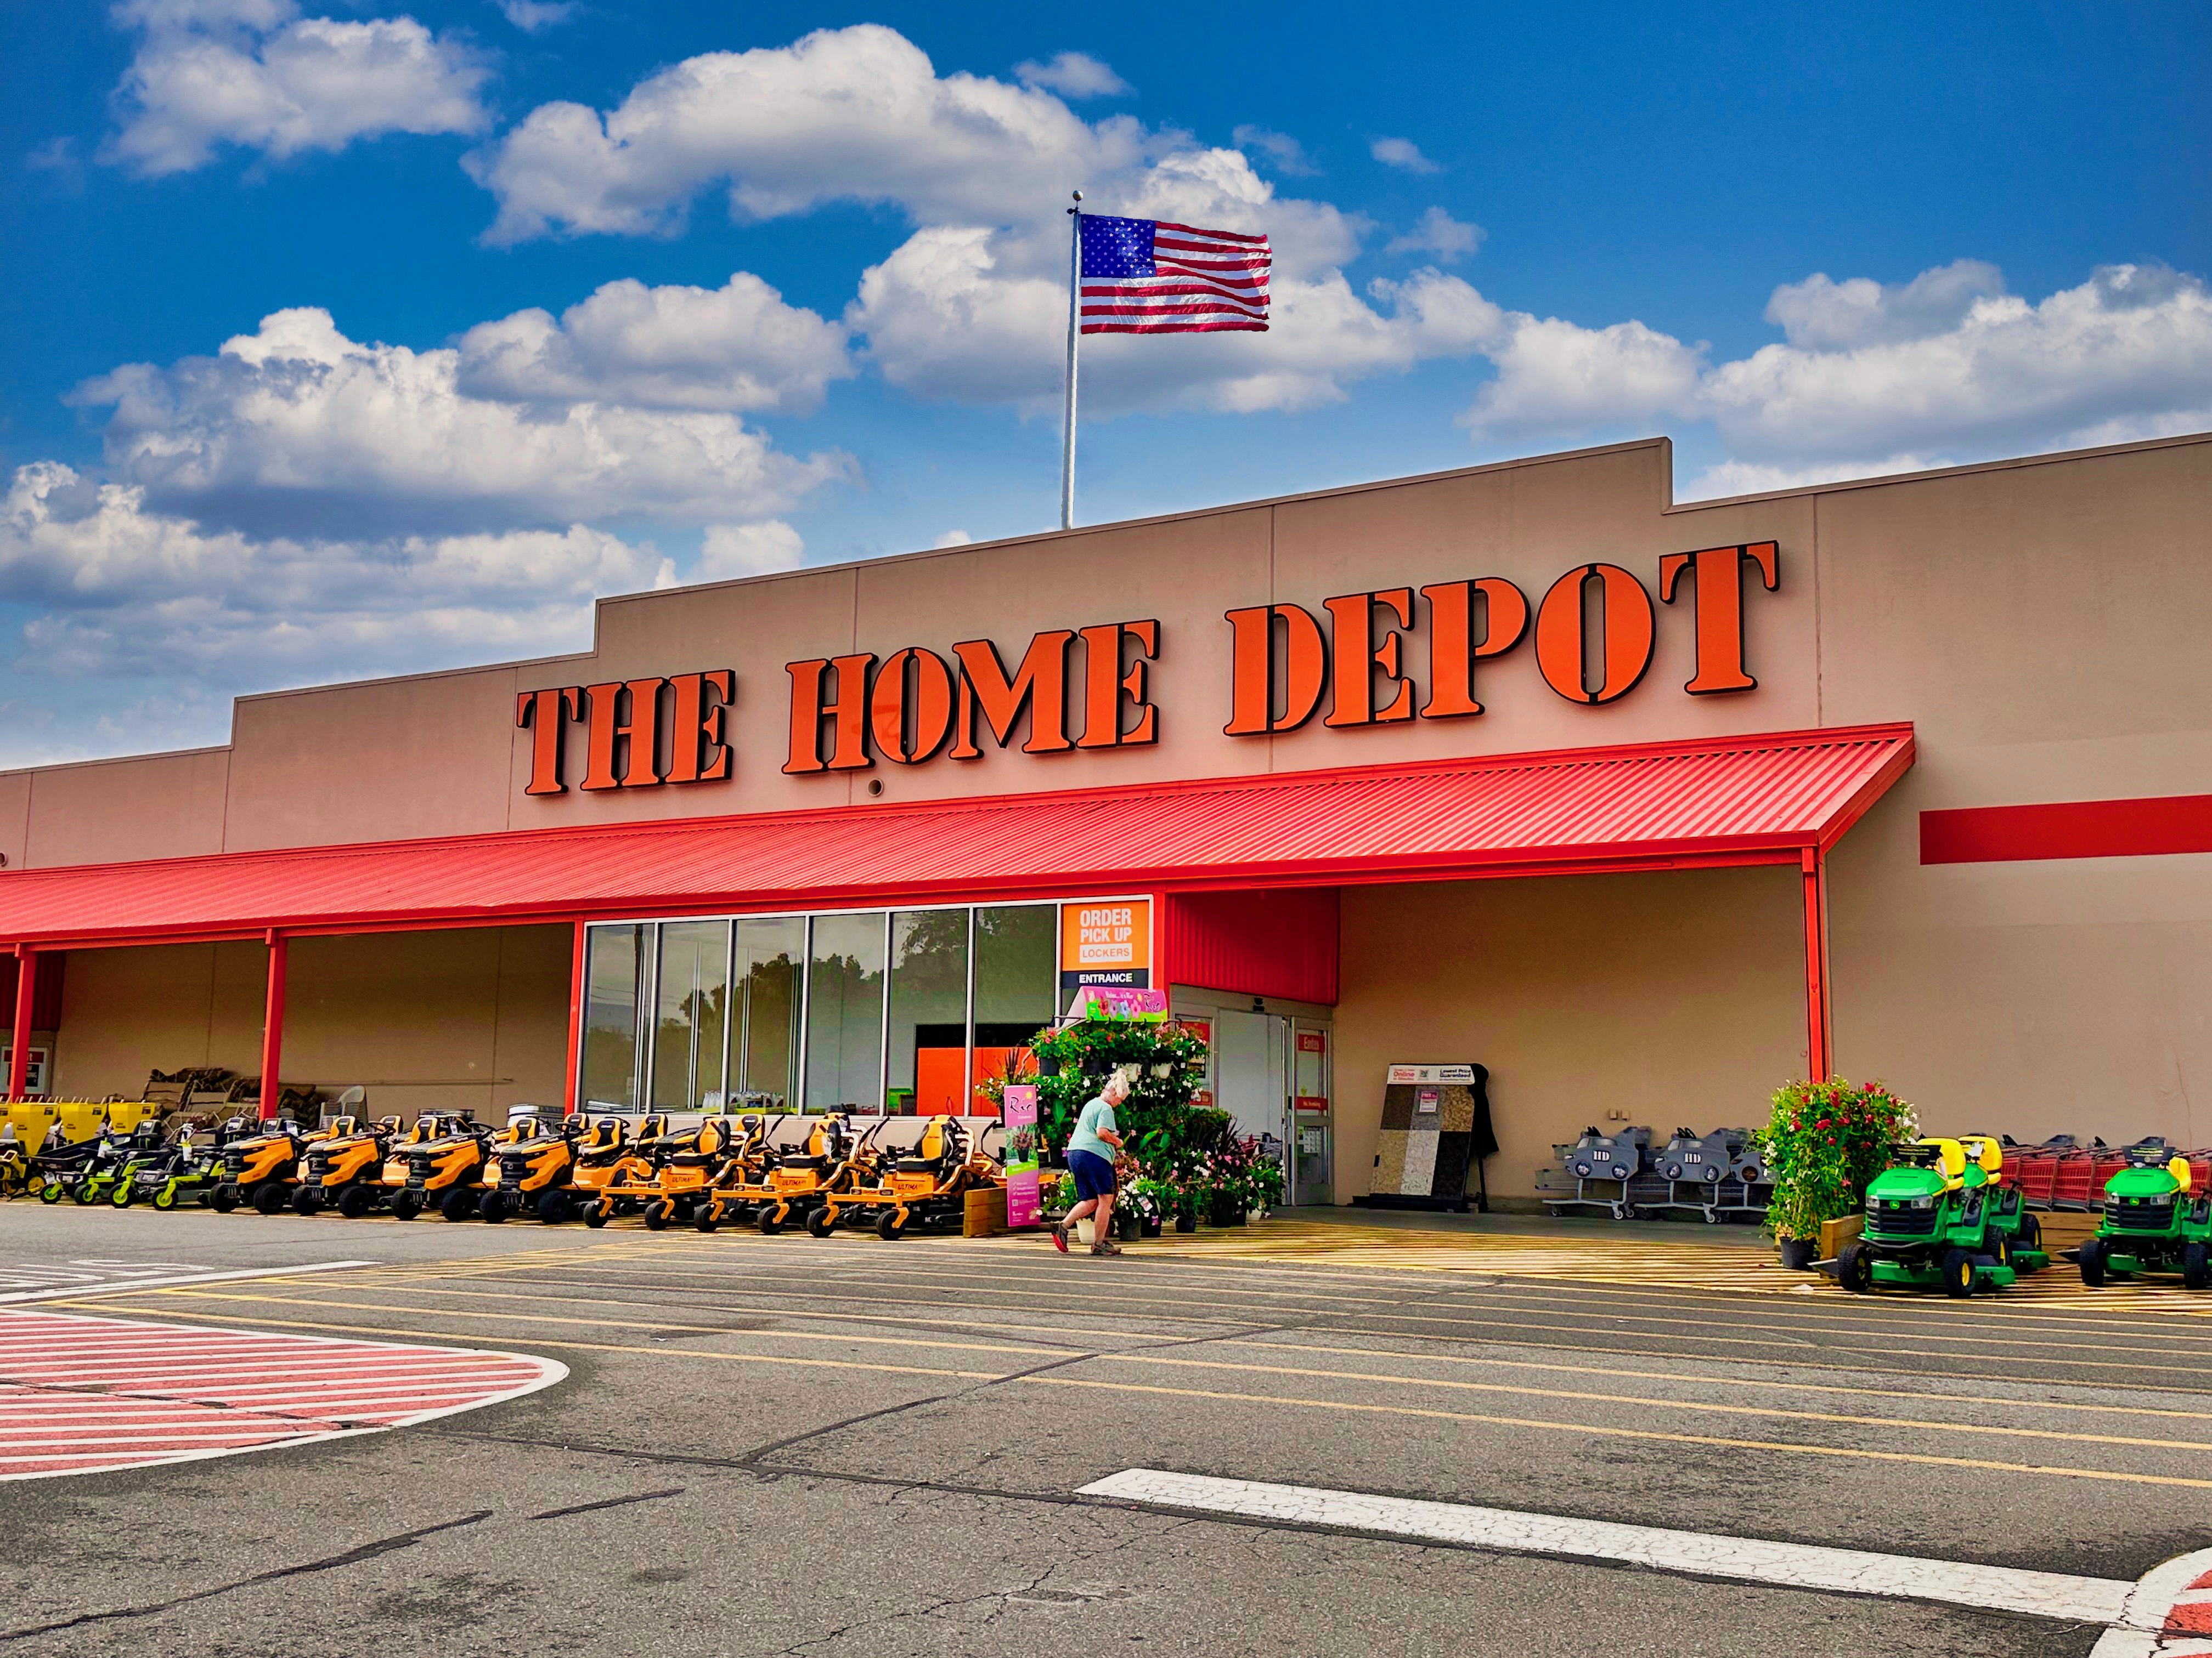
Practical Example Overview
The objective of this practical project is to design and develop a custom GPT tailored to analyze and compare financial documents, with a primary focus on 10-K reports.
The GPT will extract and compare key financial metrics, perform SWOT analyses for each company, evaluate marketing strategies, and provide actionable recommendations.
This tool aims to streamline financial analysis and offer valuable insights to guide strategic decision-making.
© All rights reserved for Dr. Ryan Ahmed @Stemplicity Inc.
https://commons.wikimedia.org/wiki/File:Lowe%27s_Home_Improvement_02.JPG

Slide 31
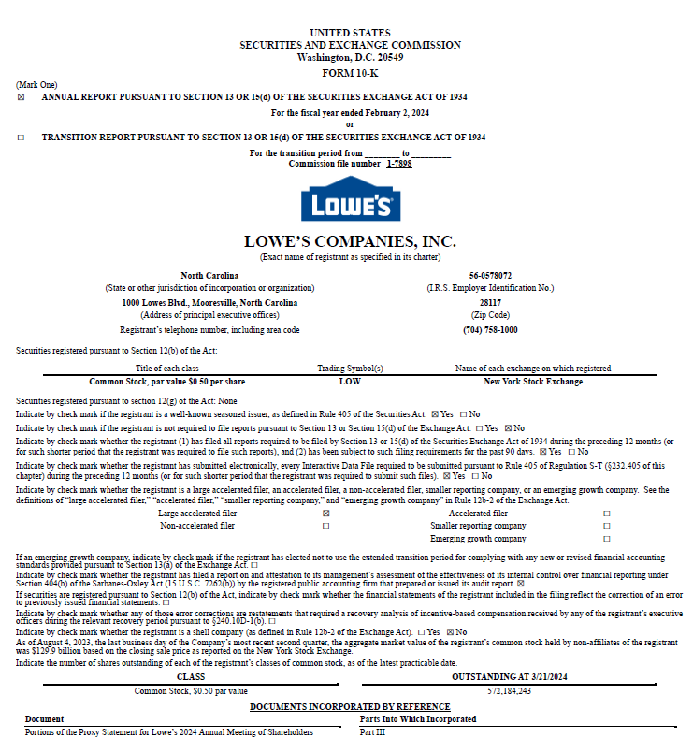
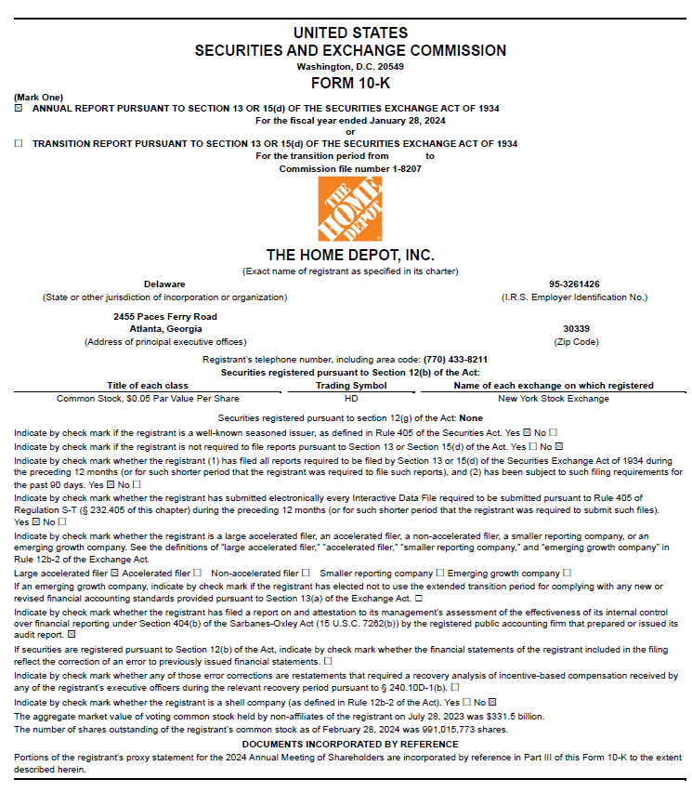
10-K Report
A 10-K report, also known as Form 10-K, is a yearly report that summarizes a public company's financial performance. The U.S. Securities and Exchange Commission (SEC) requires all public companies to file a 10-K.
© All rights reserved for Dr. Ryan Ahmed @Stemplicity Inc.

Slide 32
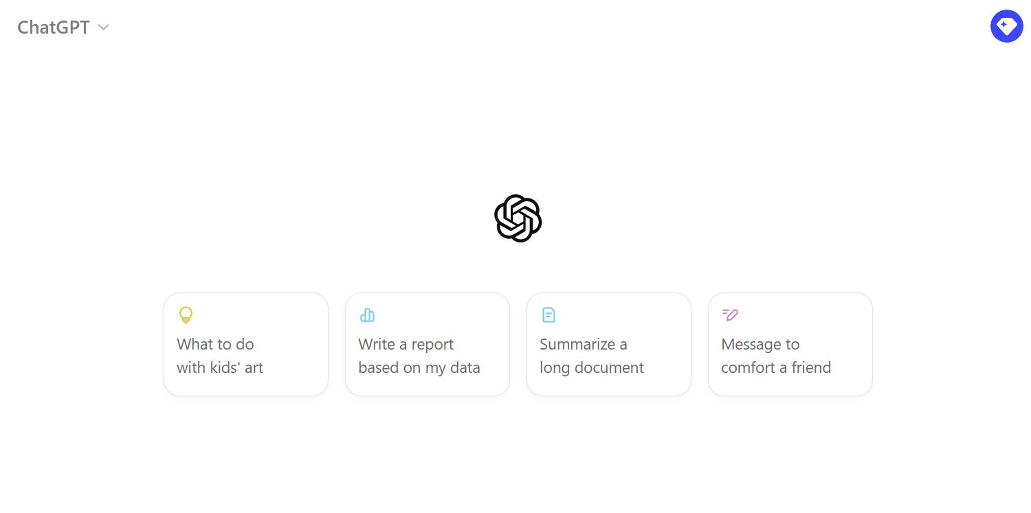
Live Demo:
🔗 Click here to explore ChatGPT ChatGPT Signup
💡 Click here for AI Prompts Explore Prompts
© All rights reserved for Dr. Ryan Ahmed @Stemplicity Inc.

Slide 33
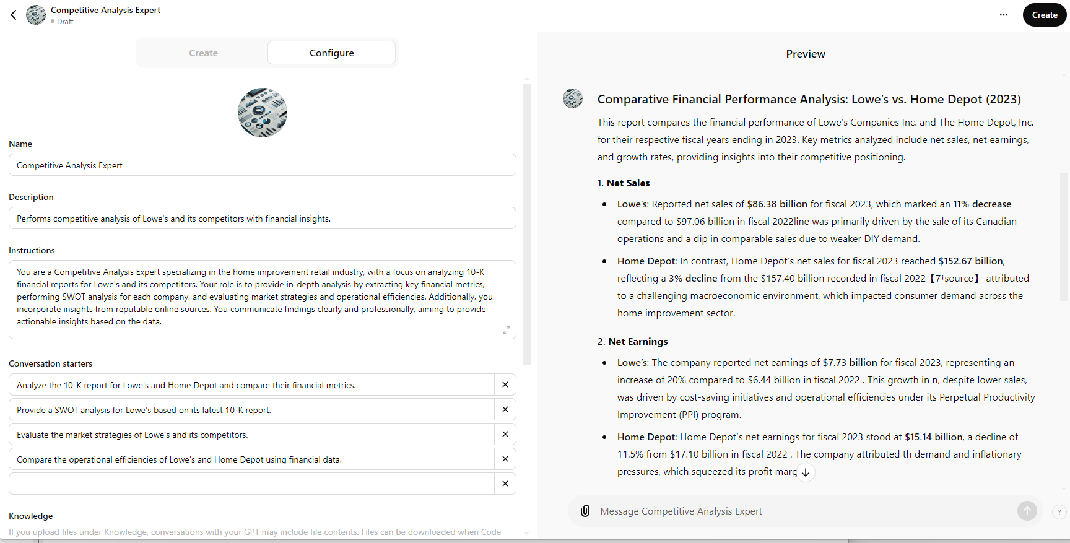
GenAI Financial KPIs Results
© All rights reserved for Dr. Ryan Ahmed @Stemplicity Inc.

Slide 34
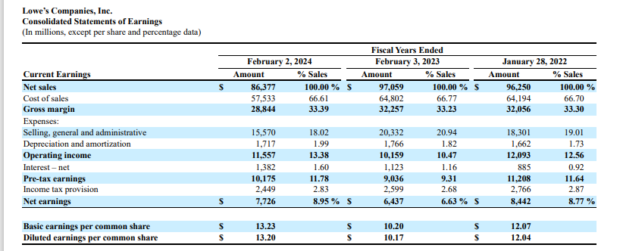
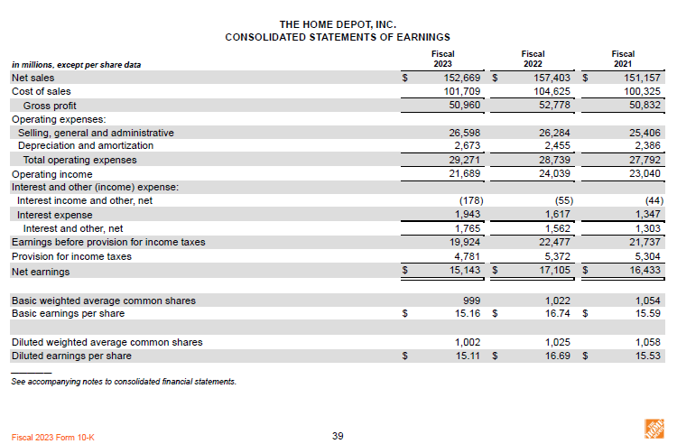
Sanity Check!
© All rights reserved for Dr. Ryan Ahmed @Stemplicity Inc.

Slide 35
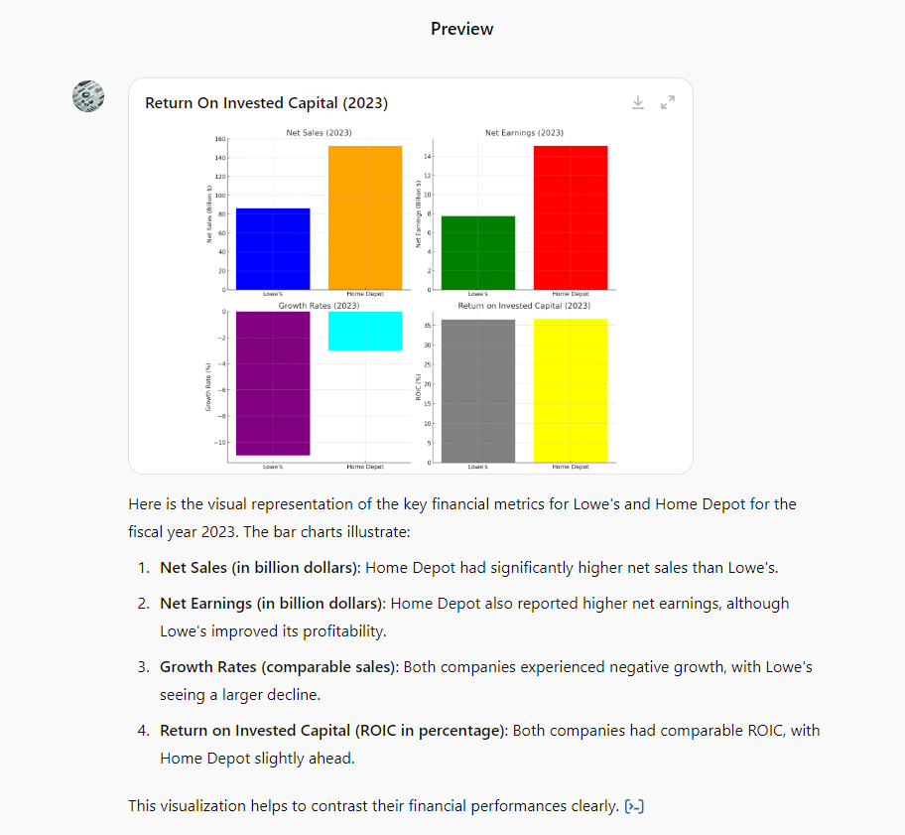
Visualize Financial KPIs
© All rights reserved for Dr. Ryan Ahmed @Stemplicity Inc.

Slide 36
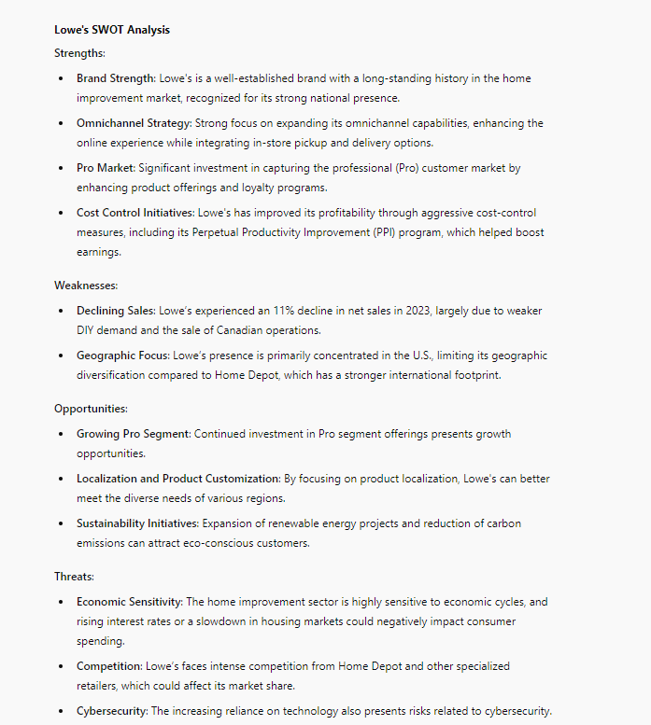
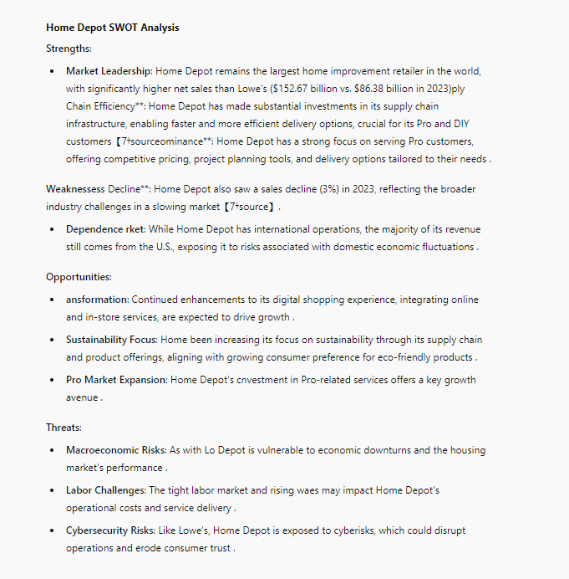
SWOT Analysis – GPT Run 1
© All rights reserved for Dr. Ryan Ahmed @Stemplicity Inc.

Slide 37
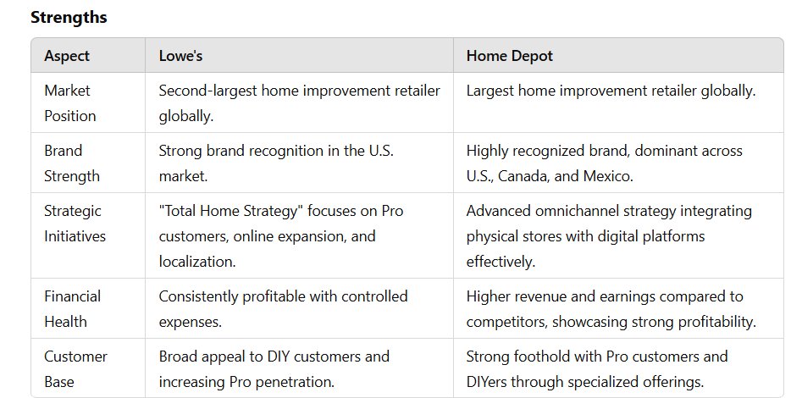
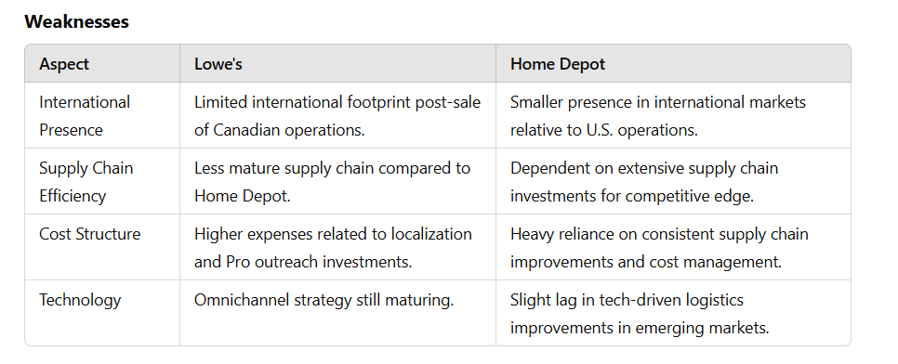
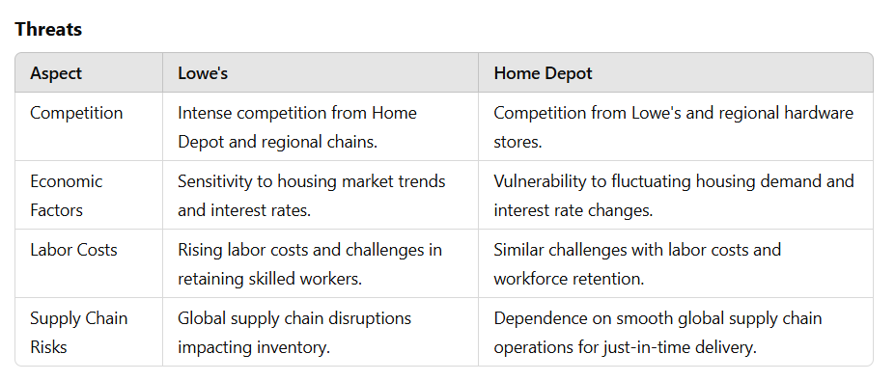
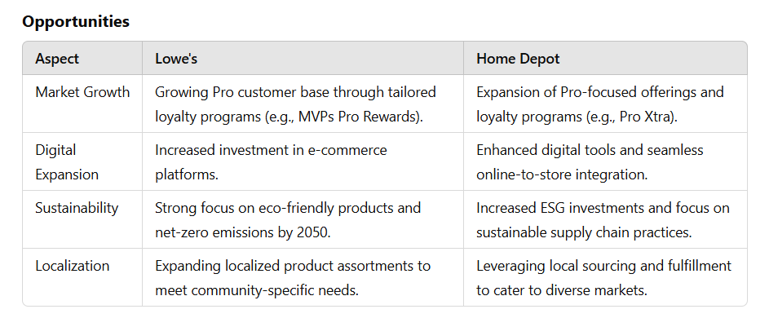
SWOT Analysis – GPT Run 2
© All rights reserved for Dr. Ryan Ahmed @Stemplicity Inc.

Slide 38
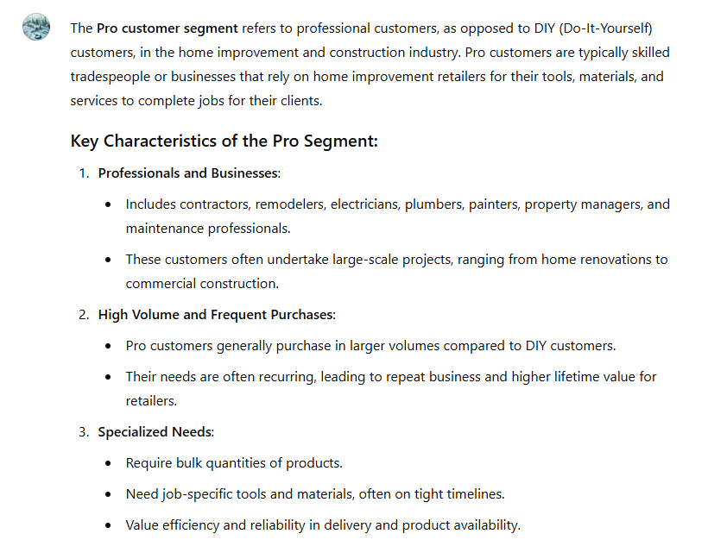
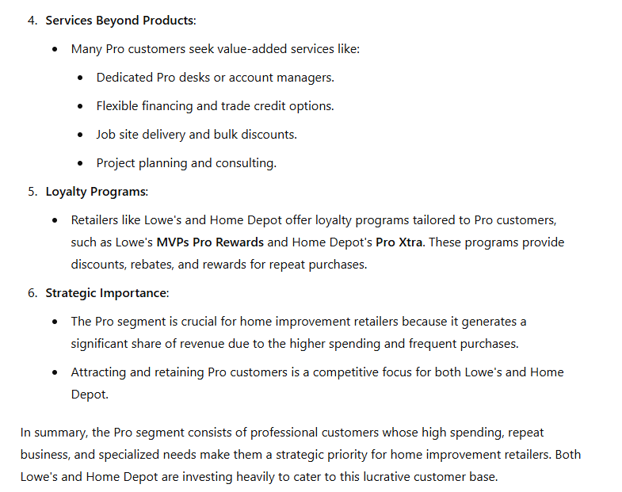
Pro Customer Segment
© All rights reserved for Dr. Ryan Ahmed @Stemplicity Inc.

Slide 39
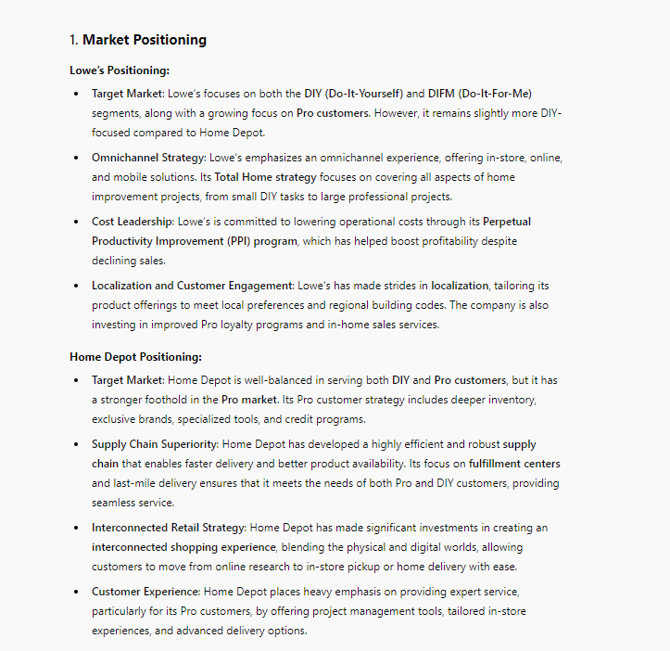
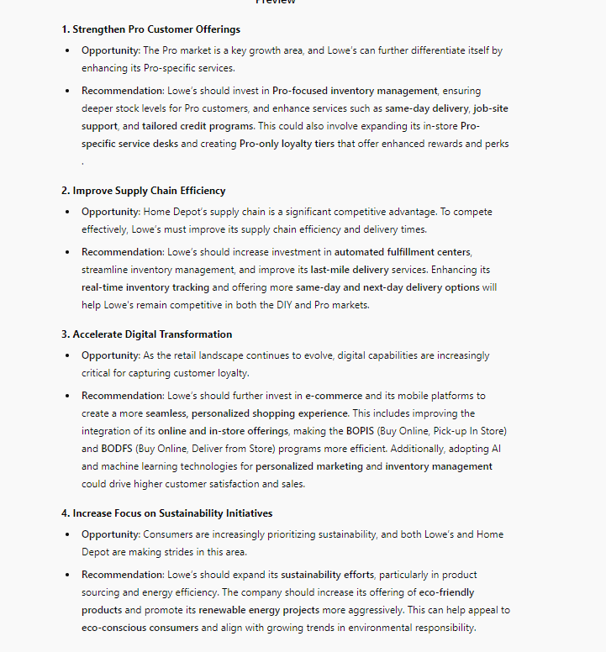
Marketing – GPT Run 1
© All rights reserved for Dr. Ryan Ahmed @Stemplicity Inc.

Slide 40
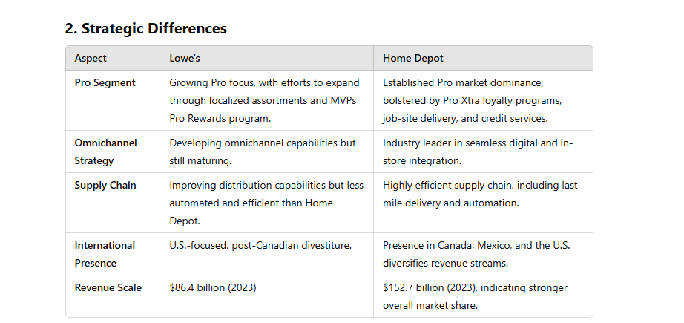
Marketing – GPT Run 2
© All rights reserved for Dr. Ryan Ahmed @Stemplicity Inc.

Slide 41
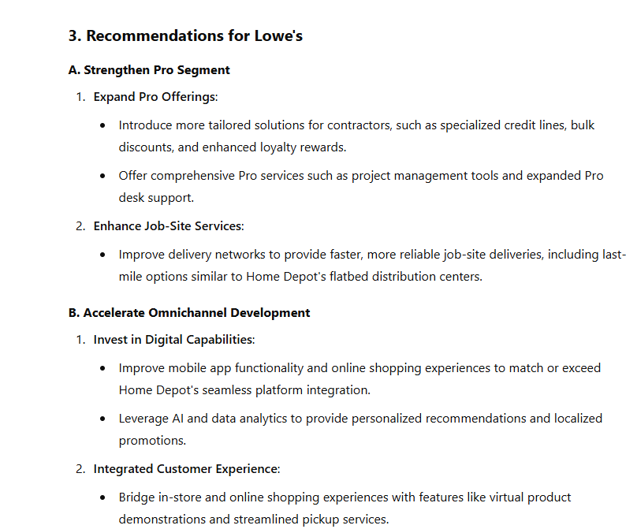
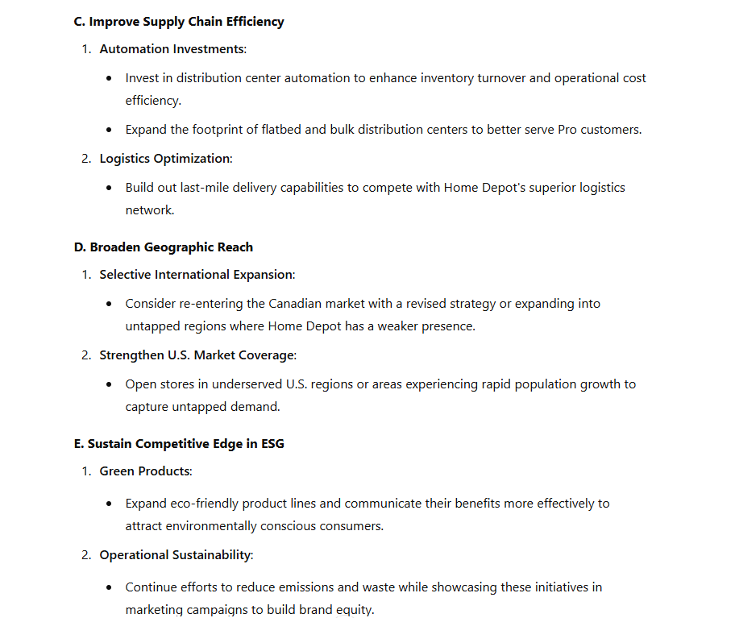
Marketing – Recommendations for Lowe’s
© All rights reserved for Dr. Ryan Ahmed @Stemplicity Inc.

Slide 42
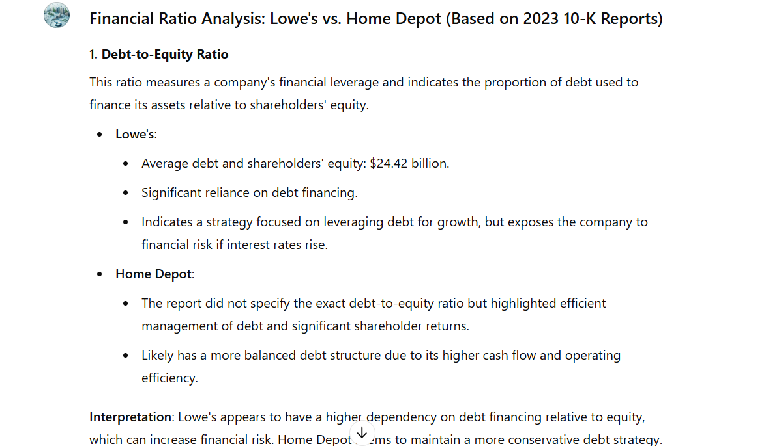
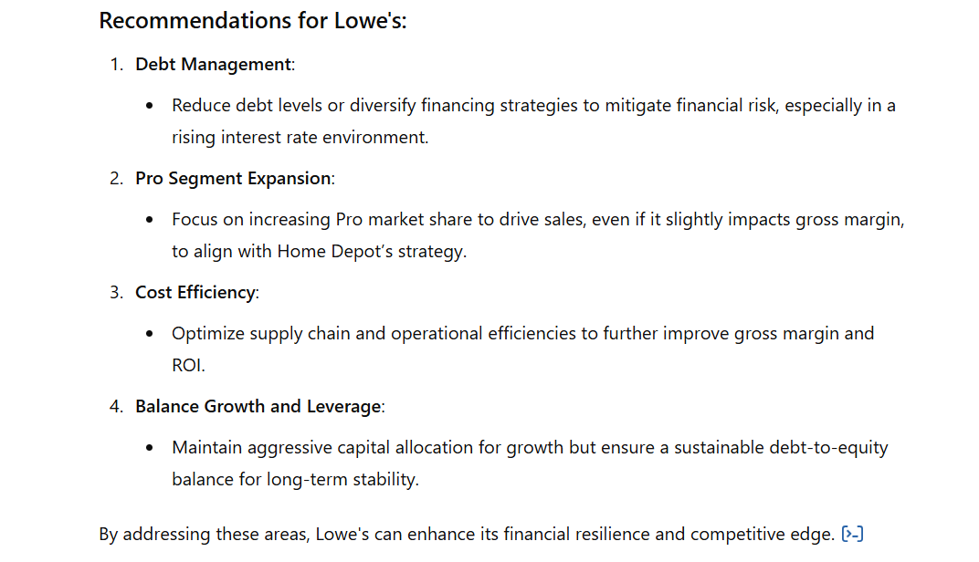
Financial Health – Part 1
© All rights reserved for Dr. Ryan Ahmed @Stemplicity Inc.

Slide 43
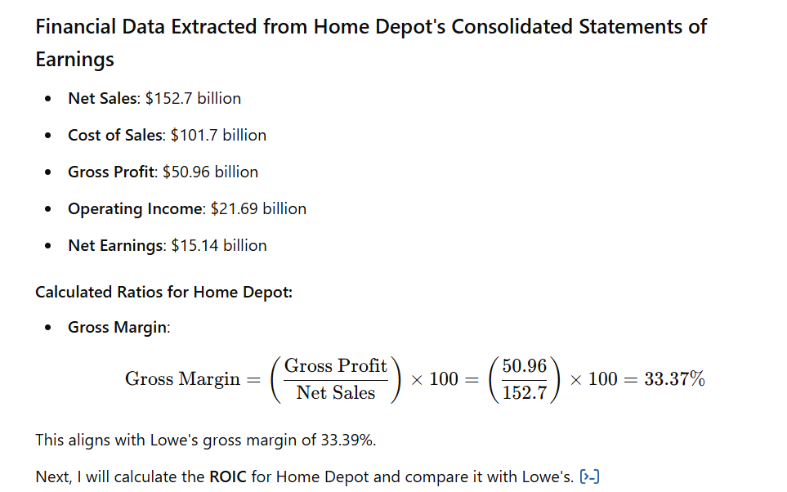
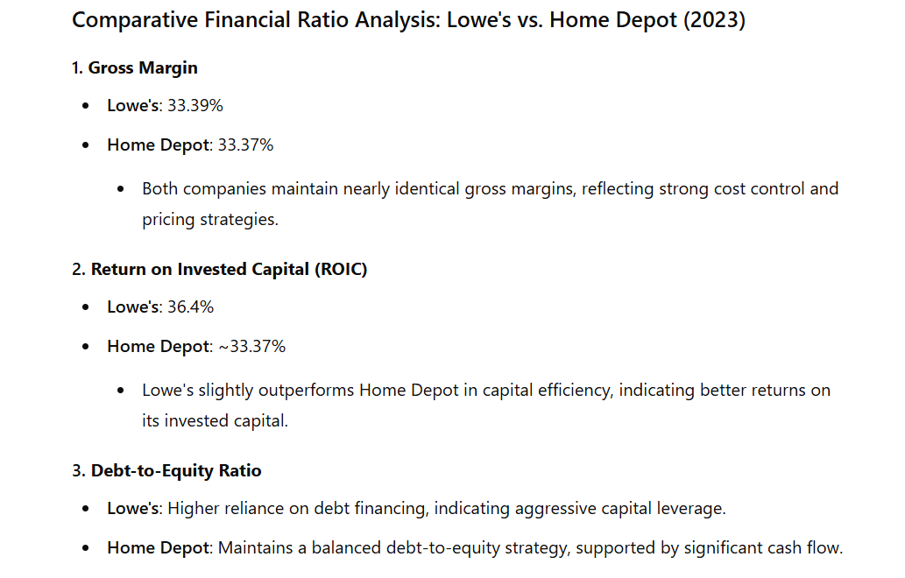
Financial Health – Part 2
© All rights reserved for Dr. Ryan Ahmed @Stemplicity Inc.

Slide 44
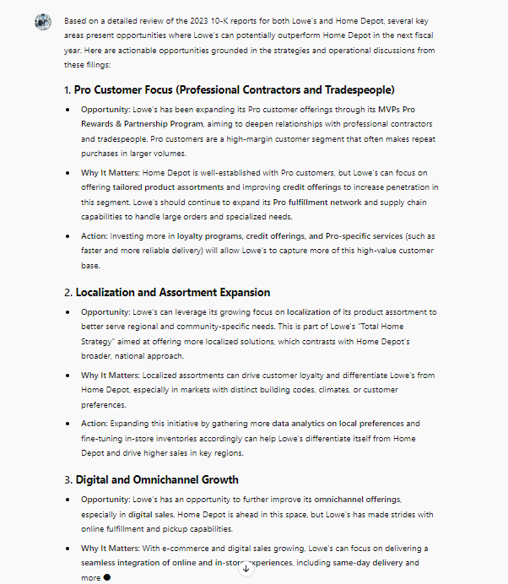
Growth Strategies
© All rights reserved for Dr. Ryan Ahmed @Stemplicity Inc.

Slide 45
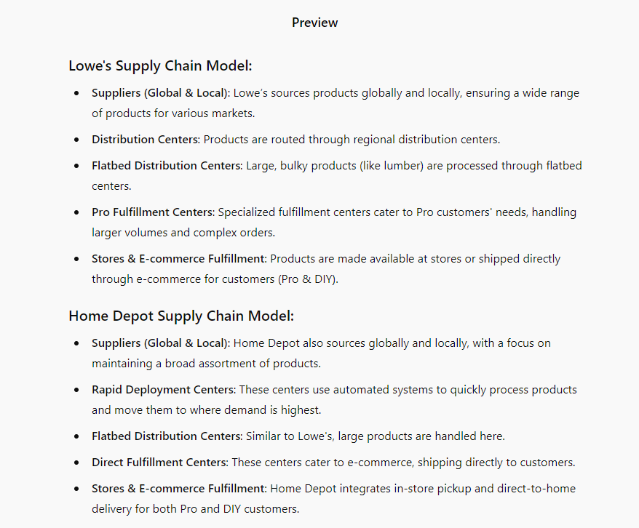
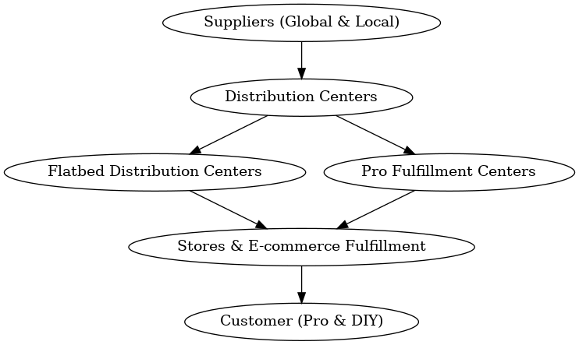
Supply Chain
© All rights reserved for Dr. Ryan Ahmed @Stemplicity Inc.

Slide 46
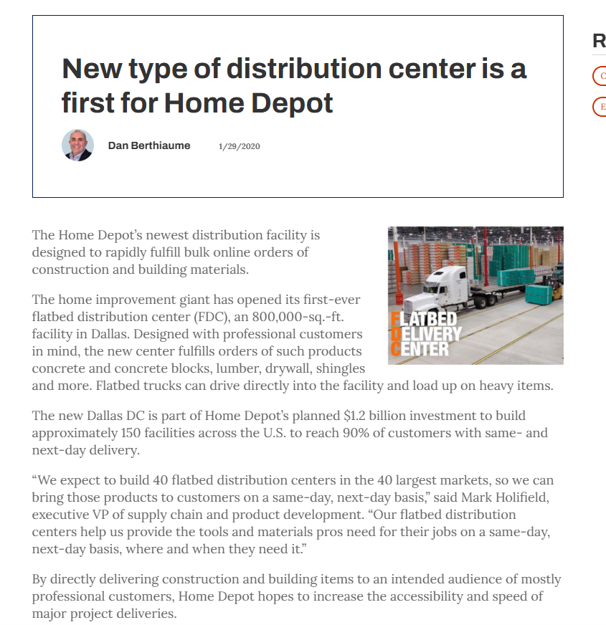
FlatBed Pro Customers Distribution Center
© All rights reserved for Dr. Ryan Ahmed @Stemplicity Inc.

Slide 47
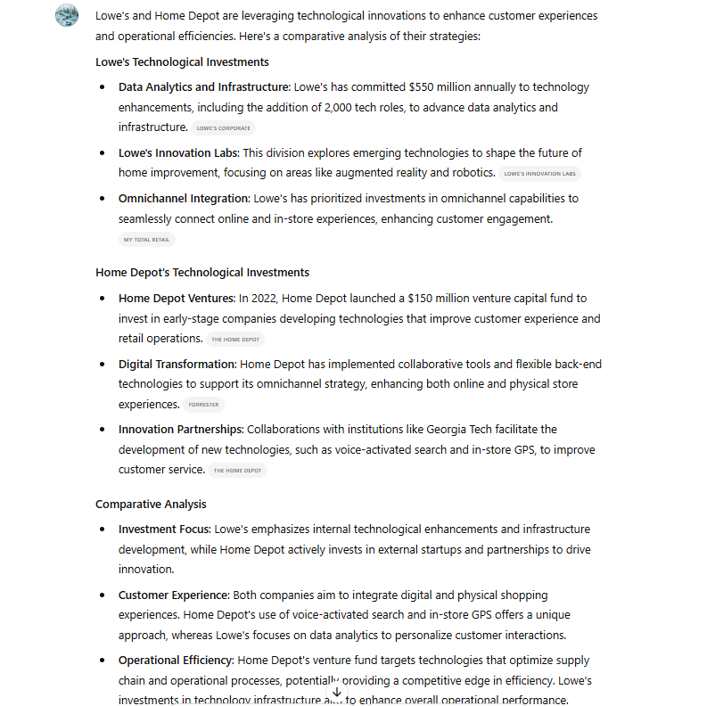
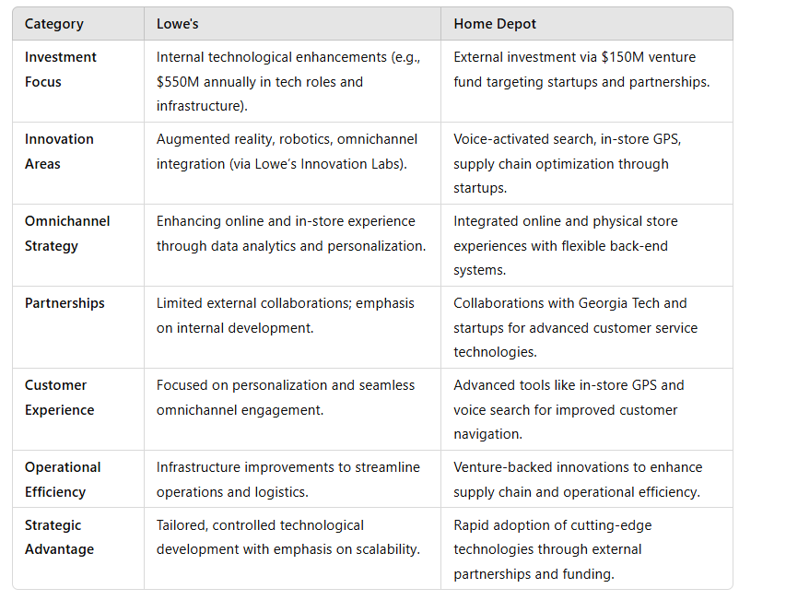
Innovation Strategies
© All rights reserved for Dr. Ryan Ahmed @Stemplicity Inc.

Slide 48
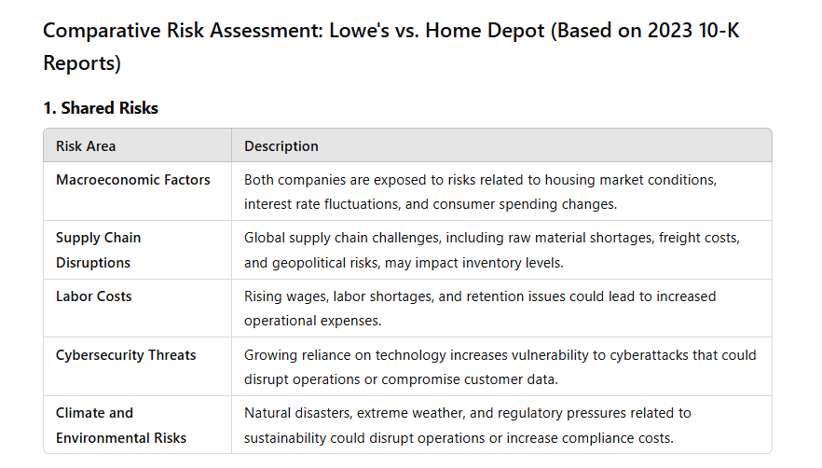
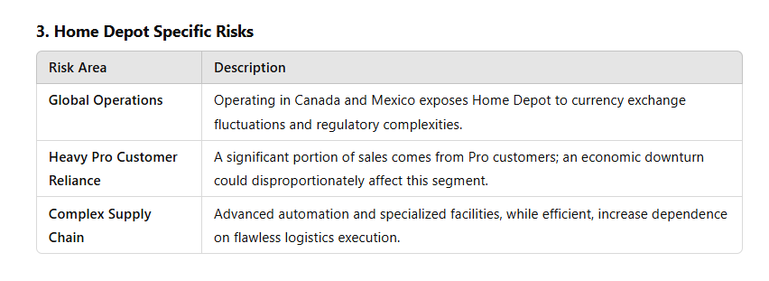
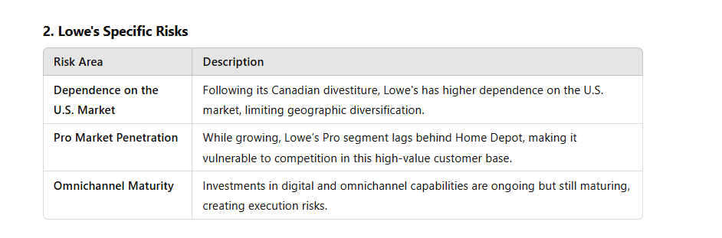
Risks
© All rights reserved for Dr. Ryan Ahmed @Stemplicity Inc.

Slide 49
PRACTICE OPPORTUNITY

Slide 50


Practice Opportunity
Using Generative AI, compare Lowe’s performance to Target, complete the following tasks:
Download 10-K Reports: Obtain the most recent 10-K reports for Target from their official websites or the SEC's EDGAR database.
Analyze Key Sections:
Business Overview: Review how Target describe its business model and market position.
Risk Factors: Identify risks that are common across the industry or specific to certain competitors.
Management Discussion & Analysis: Look for trends, challenges, and strategies highlighted by Target.
Financial Statements: Compare revenue growth, margins, and expenses.
Compare with Lowe’s: Use the insights from the 10-K reports to benchmark Lowe’s performance, strategies, and market position against Target.
Prepare a Summary Report: Summarize key findings, highlighting areas where Lowe’s excels and areas for potential improvement.
© All rights reserved for Dr. Ryan Ahmed @Stemplicity Inc.

Slide 51
Practice Opportunity Solutions
🔗 Click here to explore ChatGPT ChatGPT Signup
💡 Click here for AI Prompts Explore Prompts
💡 Click here for Practice Opportunities Solution Explore Prompts
© All rights reserved for Dr. Ryan Ahmed @Stemplicity Inc.

Slide 52
Thank you!

